Slide 1


MV Falls Prevention Coalition 2021
Agenda:
Falls related highlights from 2020 survey
Updates from 5 workgroup leaders
Group Discussion of findings
Next steps
Updates
April 20, 2021
ctrish@hamv.org
508 693-7900 ext.455

Slide 2
The Island Older Adult population is sizable and growing
I in 3 are currently 65+, outpacing national average of 1 in 5
Growth rates for 65+ higher than other age cohorts
70% of 65+ have HH income <$75k (2015 Nielson)
This forecasts do not account for COVID related impact
*UMass Donahue Growth Rates

Slide 3
Who participated in the survey?
Survey results in most cases are representative of the island’s demographics
Surveys sent to every household with a 60+ resident
Respondents could complete the survey online and in Portuguese

Slide 4
2020 Older Adult Survey – a snapshot of our island
Almost 2,500 60+ respondents completed a survey (online or paper) from Oct, 2020-Jan, 2021 – 66 questions.
Balanced representation from all towns (averaging a 30% response rate).
Representation from all age ranges with 15 surveys completed by 95+.
Questions 1,2, 6, 56 (Dec, 2020 HAMV survey)

Slide 5
More on our Older Adult participants
Almost two thirds of Older Adults report an annual household income of $100k or less
Slightly more female participants (60% versus 40% male) in-line with island population
12% are veterans*
Race/ethnicity mix in-line with known population statistics for the island (.2% identified as Brazilian)
*6.6% of Island population are veterans of which 70% are over 65
Questions 55, 57, 60, 68 (Dec, 2020 HAMV Survey)

Slide 6
Here to stay and most likely in a single family home
Vast majority (>90%) identify as permanent with 75% reporting “living on island for 12 months in 2019”.
87% own their own home and 3% live in a subsidized rental situation (IEH etc.)
The likelihood of owning a home outright (without a mortgage) increases with age to almost 70% of 85+ homeowners.
A less expensive home, lower cost of living and closer to family are top three triggers for a move, off- or on-island.
Questions 1,2, 7, 8, 11 (Dec, 2020 HAMV Survey)

Slide 7
3 out of 10 Older Adults live alone and this increases with age
Question 66 (Dec, 2020 HAMV Survey)

Slide 8
While the majority don’t report problems with infrastructure, a quarter cite road maintenance, parking, sidewalks and bike paths as issues
Question 28 (Dec, 2020 HAMV Survey)

Slide 9
How our Older Adults Feel
It’s all relative

Slide 10
We see ourselves as (relatively) healthy and valued
9 in 10 older adults rate their overall physical, oral and mental health as excellent or good as compared to “most people your age” .
However, 20% report mobility issues.
The vast majority of older adults, regardless of age, feel valued by the Vineyard community.
The responses to these 2 questions are almost identical to the 2015 survey responses.
*Question 33, 40 & 41 (Dec, 2020 HAMV survey)
The Vineyard community values the opinions and thoughts of our older adults*

Slide 11
Health Conditions increase with age, with mobility, hearing and eyesight similarly affected
Question 37 (Dec, 2020 HAMV survey)

Slide 12
Frequency of falls and changes in physical health increase with age
Almost 20% reported a fall in the last year, which increased to 40% for older adults 85+
Changes in physical health were reported by 1 in 5 older adults, surpassing changes in oral or mental health
Question 38 (Dec, 2020 HAMV survey)

Slide 13
Older Adults
Looking Ahead
More will need more

Slide 14
Anticipated service needs broaden especially for older age ranges
Question 48 (Dec, 2020 HAMV survey)

Slide 15
40% of older adults anticipate the need for safety related home modifications and this increases with age
Question 53 (Dec, 2020 HAMV survey)

Slide 16
The Human side of the numbers
Meet 4 Older Adults who represent each age range

Slide 17

70%
of survey respondents 60-64 work for a non- Vineyard employer
Daily Life…
Jane has lived on the Island, at least part-time, for most of her adult life and owns a home in Edgartown. She works full-time for a company in Boston and volunteers on a weekly basis for the Island Food Pantry.
78%
of survey respondents 60-64 work to earn an income.
She is somewhat aware of the services on Island for older adults but does not use them or feel the need to.
On the weekends, Jane spends time exploring the trails, taking beach walks and facetimes with her grandchildren!
Jane, 63
"The Council on Aging? I'm not old enough for that!"
92%
of survey respondents, 60-64 have a smartphone.
Looking ahead...
Jane plans to retire on the Island and it is very important to her to stay in her home.
She understands this might not be possible, and would consider moving off Island to be closer to family and a lower cost of living.
337 respondents 60-64

Slide 18

1 in 3
survey respondents 65-74 attend lectures, performances, art shows, author talks, cultural events.
Daily Life…
..
Alan lives with his wife of 40+ years in Vineyard Haven, he is planning on retiring in the next few years and recently transitioned from working from full to part-time.
He and his wife have been active volunteers and enjoy attending the Island's lectures, performances, talks, and more. Alan sits on the board of the Boys & Girls Club and is an active town committee member.
1 in 5
survey respondents 65-74
serves on a non-profit or charity board or committee member
Recently his wife received a diagnosis of dementia which may curtail in what he can participate in going forward.
Alan, 70
"I love being a part of this Island community!"
67%
of survey respondents 65-74 live with a spouse or partner.
Looking ahead...
Alan and his wife have no plans on leaving the Island unless they can't receive the support they will need as his wife's dementia worsens. While they were looking forward to sharing their retirement years in this beautiful place, Alan has some concerns about being far away from their adult children.
1122 respondents 65-74

Slide 19
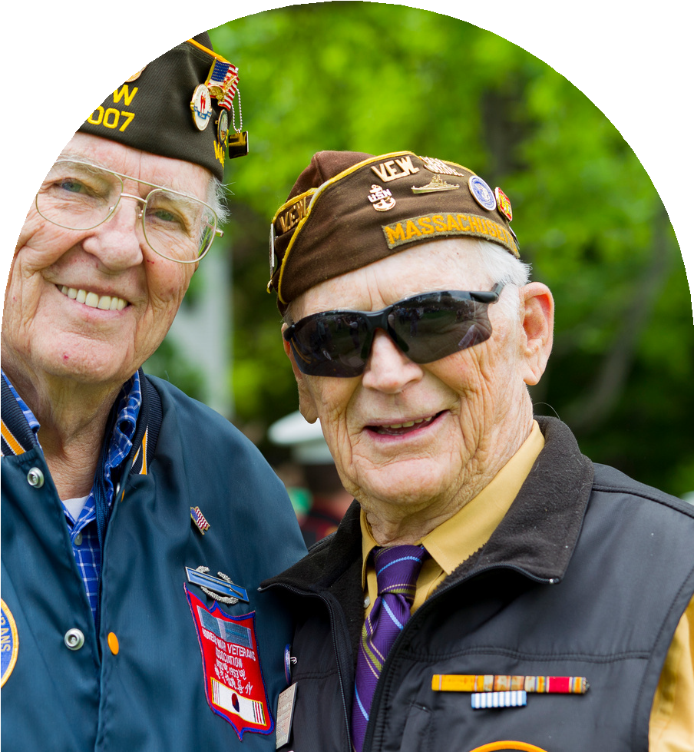
4 in 10
survey respondents 80+ have developed mobility issues.
Daily Life…
Henry is a retired Veteran who lives in Oak Bluffs. Henry spends a lot of his free time volunteering with the local animal shelter and goes to the Council on Aging for lunch and occasional social activities (pre-COVID).
Henry's wife died last year and he has relied on fellow Vets and friends for emotional support, even though he keeps his feelings close to his vest. He lives alone in an old house "older than me!" which sometimes feels too big just for one.
25%
survey respondents 75-84 are
interested in trying new things
Henry, 80
"My greatest honor was to serve my country."
50%
of survey respondents utilize the Senior Centers by the time they reached their 70s.
Looking ahead...
Henry wants to learn a new language this year. He's also recognizing that he's having trouble getting up his stairs and will need to make some home modifications in the future.
633 respondents 75-84

Slide 20
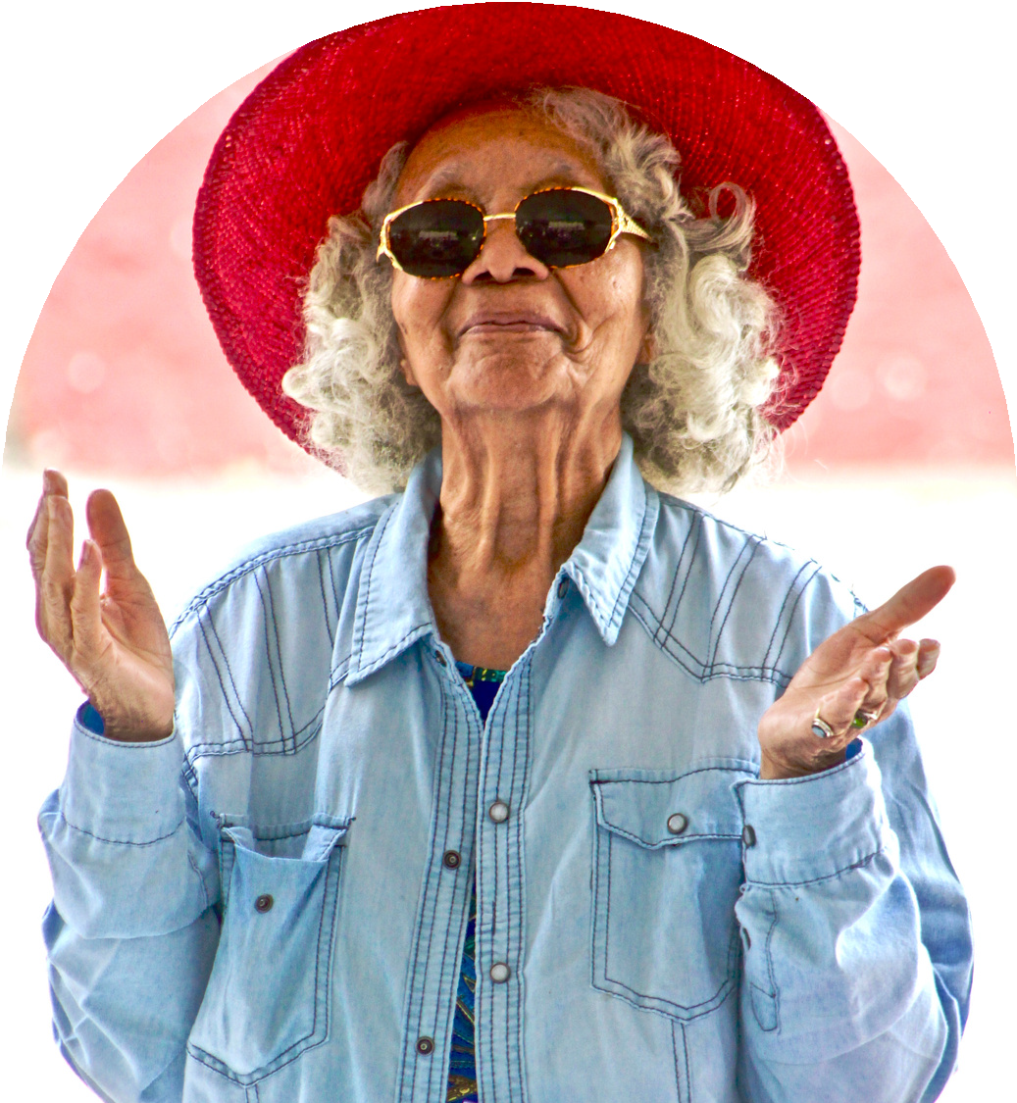
79%
survey respondents 85+ say it is very important to stay on the Vineyard.
Daily Life..
Mable lives with her four-legged friend at Island Elderly Housing and is an active member of her book club and attends church regularly.
Mable has lost some of her vision and does not drive anymore, but utilizes the Lift and VTA. She is an avid cook and uses her SNAP benefits to get vegetables through from the mobile market.
50%
survey respondents 85+ involved in community leisure activities: bridge, poetry, book club
She has a smartphone, but prefers reading the MV Times and Vineyard Gazette for updates.
Mable, 90
"My life is full and I thank God everyday for that"
Looking ahead...
30%
survey respondents 85+ would like a phone call for news updates vs. email or newspaper.
Mable plans to stay on the Island and recognizes that she may need some more support in the future. Her family is not on Island, and Mable has concerns about paying for a home health aide in the futue.
207 respondents 85+

Slide 21


We’ve identified our focus areas for 2021
Education/Prevention
Strengthening healthcare connection
Improving safety in homes and our communities
Digital access
Metrics of Success
….and the work groups as well!

Slide 22
Updated Focus Area Work Groups
Education/ Prevention | Strengthening Healthcare Connection | Improving Safety in our Homes and Communities | Digital Access | Metrics of Success
Lead: Tanya Larsen | Lead: Thaddeus Thompson | Lead: Megan Panek | Lead: Betty Robie | Lead: Ian Campbell
Joyce Stiles-Tucker | Cindy Doyle | Catie Blake | Lorna Andrade | Bob Laskowski
Suzanne Robbins | Lori Perry | Cheryl Kram | Anne McDonough | Kathleen Samways
Valci Carvalho | Marina Lent | Victoria Haeselbarth | Cindy Trish
Lila Fischer | Lisa Hollander | Michele LeBlanc
Rose Cogliano

Slide 23
Education/Prevention Focus Area
Community education
            Identifying the right content (and do we want to update our current brochure?)
            Defining the audience
            Communications campaign - frequency of messaging
            Delivery Methods (print, digital TV, radio)
            Falls Prevention Month (Sept) - how do we want to participate?
Prevention
An audit -what prevention programs currently exist on the island?
Investigation of evidence-based programs (including Matter of Balance which has gone quiet)
Selection and implementation of a prevention programs (if identified as a need)

Slide 24
Strengthening Healthcare Connections Focus Areas
Purpose: Leveraging the strengths and talents of all island organizations and increase the visibility of coalition
            Map the connection points between different organizations for falls prevention/recovery (as an example, hospital care for a fall followed up by participation in a YMCA program)
            Communicate and raise awareness of these connection points and coalition’s role
            Use this knowledge to identify gaps and where the coalition can “lean in”

Slide 25
Improving Safety in our homes and communities focus areas
Advocacy, Awareness and Facilitation
            Advocate for those who have a need for falls prevention efforts
            Create awareness for programs/information to increase safety
            Facilitation – bringing together different organizations to provide an integrated approach to improving safety (look for overlap with Disabilities Coalition)
            Identify programs for the home – e.g. home audits
            Look for “low hanging” fruit in the community

Slide 26
Digital Access Focus Area
Dedicated to improving safe, accessible, affordable digital access to Fall Prevention training, information, resources for older adults
Identify hardware and software needs and local resources available
Create local, (e.g. Disabilities Coalition and schools), state and national partnerships sharing this vision
Explore funding sources/implementation

Slide 27
Metrics of Success Focus Area
Create an annual message/story to demonstrate effectiveness
            Stories (qualitative) of impact of falls prevention on community members – for each focus area of the coalition
            1-2 standard metric (quantitative) tracked at the state level (TBD)
            Economic savings from falls prevention (TBD)
            Multiple modes of delivery (video, press releases, newspaper articles)
            Identified Sources of information – a starting list
            Screening data from the hospital (collected during wellness visits, falling history/likelihood of falling)
            Home Safety Modification Program pre/post survey data
            Older Adult 2020 Survey data, EMS data, what else?

Slide 28
Follow Up Discussion Questions
Are there areas of synergies/overlap we need to address?
Outside of “people power” do we need budget to move forward with any of the recommended actions? If so, where could we find it?
Are there any organizations that we should be inviting to join the Falls Prevention Coalition?

Slide 29
Current Falls Prevention Coalition Members
Broad representation from island organizations but always room for more!
Lorna Andrade, drlorna.andrade@hotmail.com
Catie Blake, cfuller@tisburyma.gov
Ian Campbell, ICAMPBELL4@partners.org
Valci Carvalho, vcarvalho@partners.org
Rose Cogliano, rcogliano@oakbluffsma.gov
Cindy Doyle, cdoylema@me.com
Lila Fischer, lfischer@ihimv.org
Victoria Haeselbarth, vhaeselbarth@edgartown-ma.us
Lisa Hollander, lisahollander@comcast.net
Cheryl Kram, ckram@capecodhealth.org
Tanya Larsen, coa-staff@westtisbury-ma.gov
Bob Laskowski, laskowskiadvisors@gmail.com
Michele LeBlanc, mleblanc@mvcommunityservices.org
Marina Lent, boh@chilmarkma.gov
Anne McDonough, amcdonough@clamsnet.org
Megan Panek, megan.panek@escci.org
Lori Perry, lperry@ihimv.org
Betty Robie, banson50@aol.com
Suzanne Robbins, SROBBINS5@partners.org
Kathleen Samways, ksamways@ihimv.org
Joyce Stiles-Tucker, jstucker@tisburyma.gov
Thaddeus Thompson, tthompson3@partners.org
Cindy Trish, ctrish@hamv.org

